Slide 1

Welcome to the Research Administrators Forum
March 4th, 2025

Slide 2
Next Up: Research Strategy & Communications Update
Gwendolyn “Gwen” Slade-Bouchie
Executive Director of Research Strategy & Communications

Slide 3
Next Up: Compliance Update
Gary Nimax, Assistant Vice President for Compliance
Meredith Mays Espino, Director of Privacy Programs
Jessie Graham, Electronic Records Manager
Anita Vannucci, Sr. Records Management Analyst

Slide 4
Compliance Updates
Research Administrators Forum
March 4, 2025

Slide 5


Privacy
Privacy - the right to control one’s own personal information
Personal information - generally, information that identifies, relates to, describes, is capable of being associated with, or could reasonably be linked, directly or indirectly, with a particular human person.
Sampling of Privacy Laws with which UVA Must Comply
VPRA
VGDCDPA
Laws often leave gaps or even contradict, especially when each law covers only one type of data or data subject.
HIPAA
FERPA
GLBA
NRA
GDPR
UVA has ~85 policies relating to privacy!

Slide 6
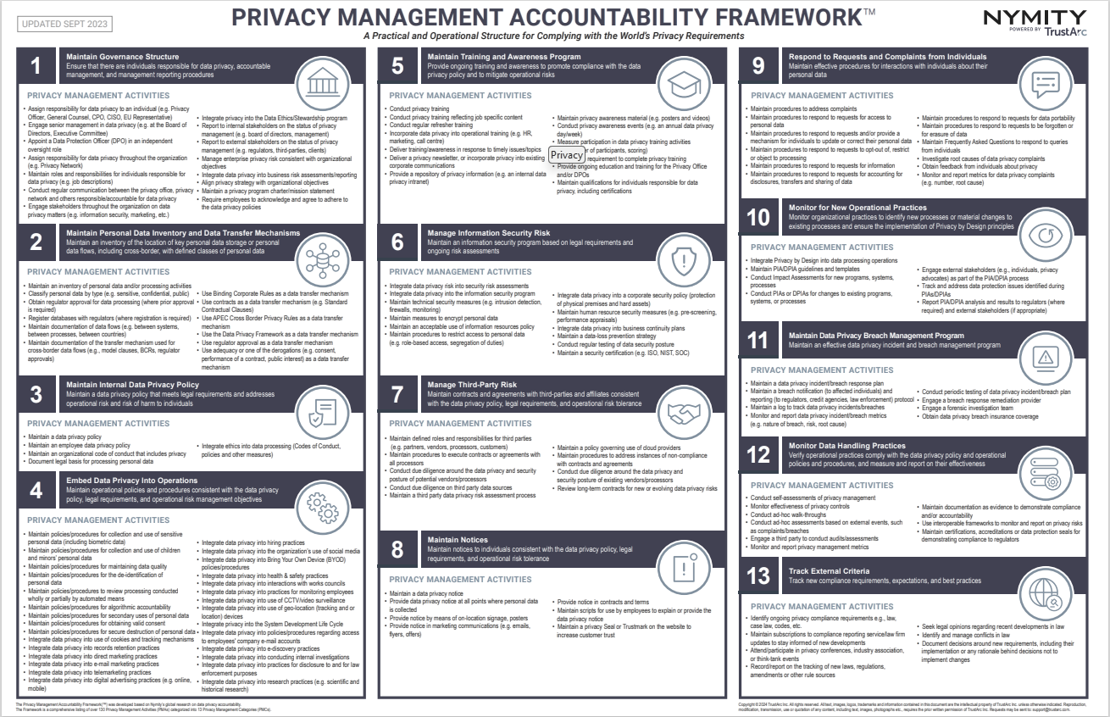
Privacy
Privacy Management Accountability Framework
Maintain a Governance Structure
Maintain Personal Data Inventory and Data Transfer Mechanisms
Maintain Internal Data Privacy Policy
Embed Data Privacy Into Operations
Maintain Training and Awareness Program
Manage Information Security Risk
Manage Third Party Risk
Maintain Notices
Respond to Requests and Complaints from Individuals
Monitor for New Operational Practices
Maintain Data Privacy Breach Management Program
Monitor Data Handling Practices
Track External Criteria

Slide 7
UVA Compliance Office
Meredith Mays Espino
Director of Privacy Programs
mmaysespino@virginia.edu
434.297.6767

Slide 8
Records & Information Management
Update

Slide 9
IRM-017:
Records & Information Management
What’s NEW:
Section 3 – Responsibilities:
All Academic Division, Medical Center, and College at Wise employees (faculty and staff) and All Board Members should receive records and information management guidance about their responsibilities as an employee/board member at the time of hire/appointment. Each agency will determine the area responsible for providing records management guidance. For the Academic Division, completion of Introduction to Records & Information Management at UVA online session is required.

Slide 10
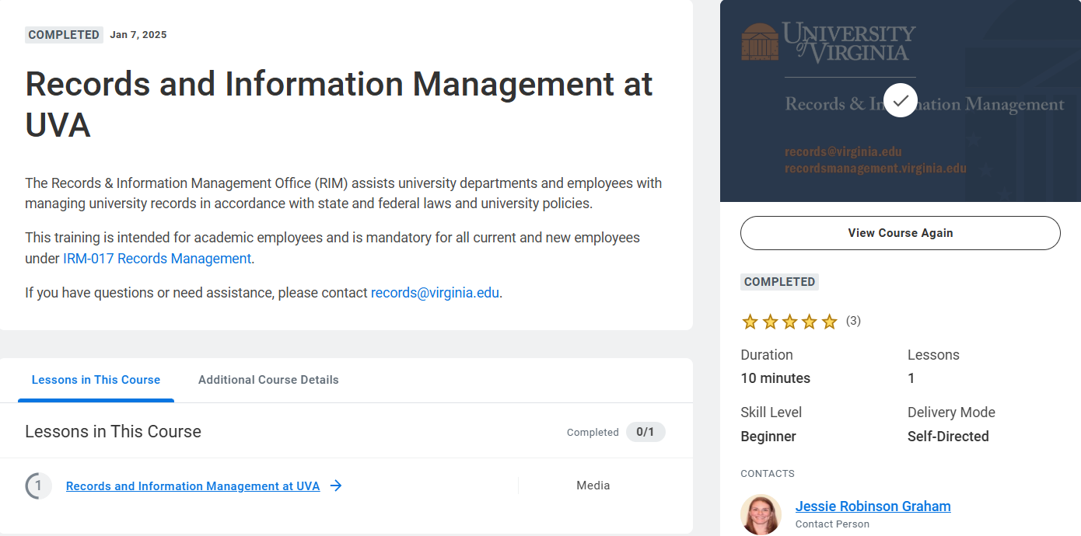
Training Assigned via Workday

Slide 11
Records & Information Management
Jessie Graham
Electronic Records Manager
Anita Vannucci
Sr. Records Analyst
Email: records@virginia.edu
Website: https://recordsmanagement.virginia.edu/

Slide 12
Signatory Authority
Signing contracts with external entities on behalf of the University

Slide 13
Signatory Authority
FIN-036: Signatory Authority for Executing University Contracts
Policy Objectives:
contract is reviewed and signed by a University representative with the requisite signature authority delegated by the Board of Visitors
the terms of University contracts are consistent with state and federal laws, directives and guidelines
all reviews and approvals required by University policies are obtained prior to execution of the contract

Slide 14
Signatory Authority
What is a Contract?
Any agreement between the University and one or more external parties for performing, or refraining from performing, some specified act(s) in exchange for a valuable benefit known legally as “consideration.”
Documents meeting this definition may be referred to by other terms (e.g., agreements, memoranda of understanding, statements of work) but they are covered by this policy if the document is being signed by both the University and any separate legal entity.

Slide 15
Signatory Authority
Required – Any document signed by both the University and any separate legal entity must be signed by an employee with an official signatory authority letter delegated by the EVP/COO.
  Note that this includes all vendors, grant sponsors, University-Associated Organizations, Contracted Independent Organizations, Fraternal Organizations, municipalities, donors, professional organizations, and non-profit organizations.
Not required – Intra-University documents signed between two schools or departments (e.g., service level agreements) do not require delegated signatory authority, provided that all parties are within the legal entity known as “The Rector and Visitors of the University of Virginia”.

Slide 16
Signatory Authority
Scope of Authority
  Individual authority is outlined explicitly in a signatory authority delegation letter from EVP/COO
Responsibilities of Signatories
  Only authorized signatories are delegated the authority to legally bind “The Rector and Visitors of the University of Virginia”
  Individuals who sign contracts without delegated authority may be held personally liable for payment & performance of the contract and face disciplinary action up to and including termination

Slide 17
Signatory Authority
Primary administrative offices with signatory authority are:
OSP for grants and contracts related to research funds;
Procurement Services for the purchase of goods and services;
Facilities Management for the procurement of construction and services;
Office of the VP & Chief Financial Officer for contracts outside the scope of Procurement Services or OSP (e.g., leases, educational services contracts, student practicum contracts, art loan agreements);
Office of the EVP & Provost for Academic Program Agreements.

Slide 18
UVA Compliance Office
Gary Nimax
Assistant VP for Compliance
nimax@virginia.edu
434-243-8992
Steve Sherman
Manager, University Compliance Program
steve@virginia.edu
434-924-3849
Email: compliance@virginia.edu
Website: compliance.virginia.edu
Reporting Options: report.virginia.edu

Slide 19
Next Up: Building a Field-Of-Dreams to Bring Innovative Translational Research into Human Applications
Dr. Jianjie Ma, Professor of Surgery

Slide 20


Slide 21

“Building a field-of-dreams to advance innovations in translational research into human applications”
Jianjie Ma, PhD, Department of Surgery, UVA (Jianjie.Ma@virginia.edu)
Research Administrators Forum Presentation – March 4, 2025

Slide 22
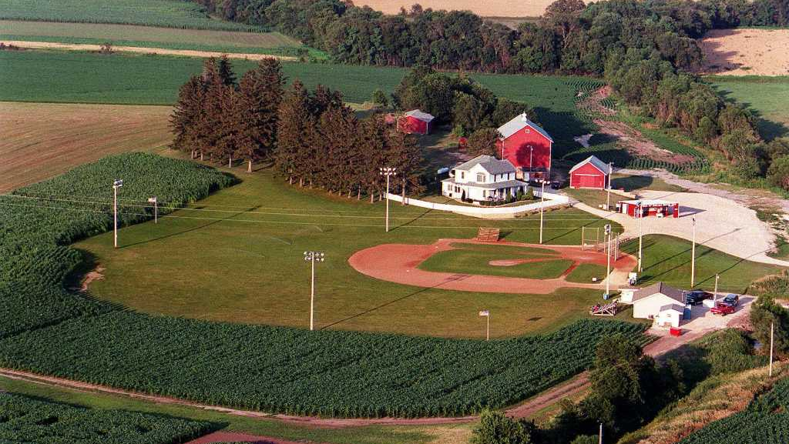
A field of dreams –
A team of physician-scientists
& basic researchers
Bench discovery bedside application

Slide 23
Unmet Medical Needs for Diabetes
Diabetes is a global epidemic, incurring a cost of ~$8.4 billion for Virginia alone.
Exercise has benefits to health and diabetes. The quest for a “exercise pill” has remained elusive for generations.
Beyond hyperglycemia, diabetes is characterized by chronic inflammation. Finding a “pacifier” to control this persistent "flame“ is urgently needed.
Diabetic foot ulcer is a severe complication, often necessitating amputation. We need a "molecular glue" to facilitate the healing of diabetic wounds.
Living with diabetes – in need of an “exercise pill”, a “pacifier” to put out the flame, and a “molecular glue” to heal.

Slide 24



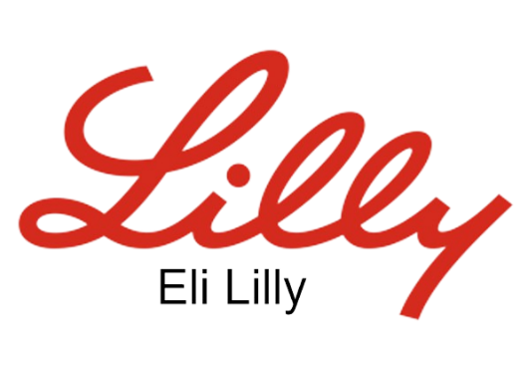
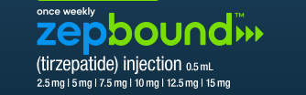
GLP-1 AGONIST
Diet control -
body weight loss
Eli Lilly
Challenge: ~60% Fat Reduction, >40% Muscle Loss
While skeletal muscle can be a victim of GLP-1-induced body weight loss, it is also an active player, taking up >70% glucose in the body.

Slide 25
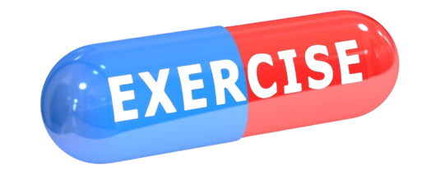
“Developing an exercise pill to combat diabetes and protect muscle function associated with drug-induced body weight loss”

Slide 26
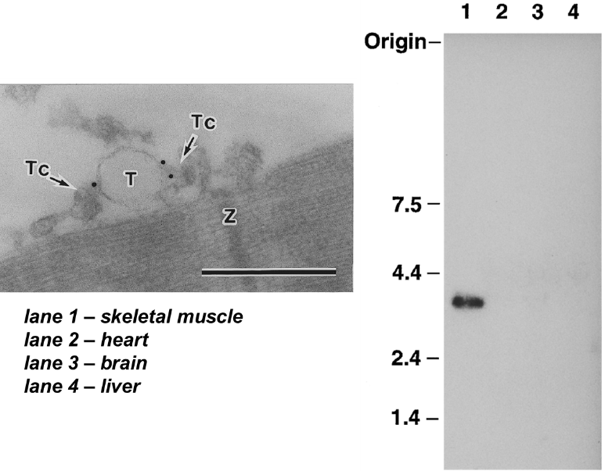
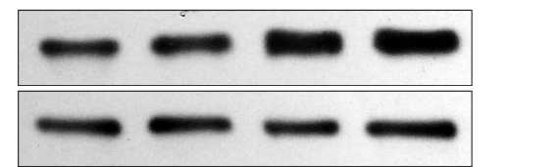

MG29 as a novel “exercise pill” to treat diabetes
a. MG29 is a muscle specific protein
b. Exercise enhances MG29 expression
basal
+exercise
MG29
Control
1 2 3 4
c. Exercise benefits require MG29
d. MG29 facilitates Glut4 translocation

Slide 27
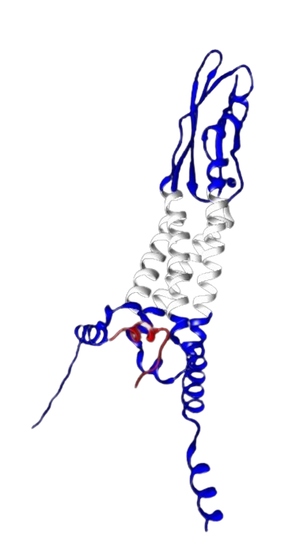
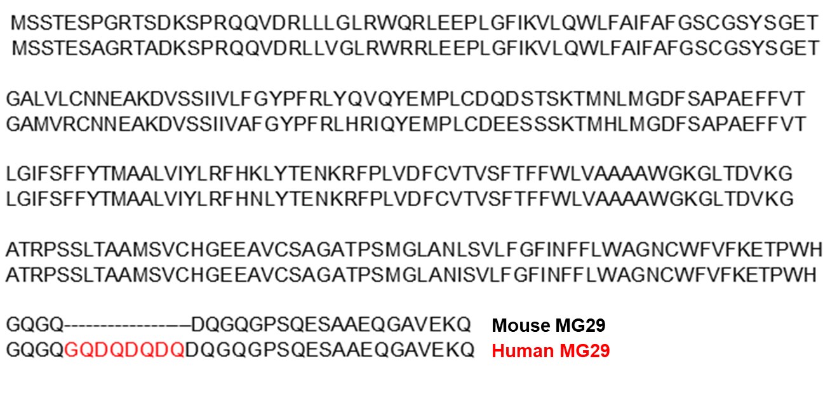
MG29 protein is conserved in rodents and humans

Slide 28
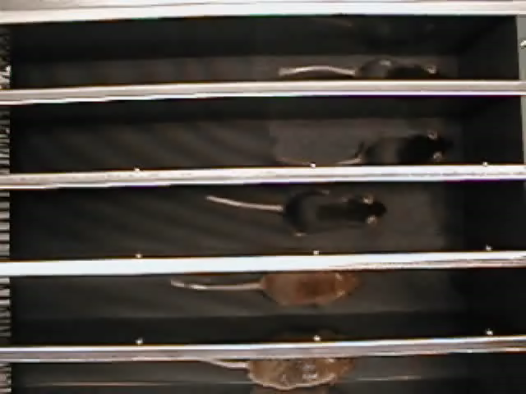
Mice without MG29 show premature aging and diabetes
mg29
+/+
+/+
-/-
+/-
+/-

Slide 29
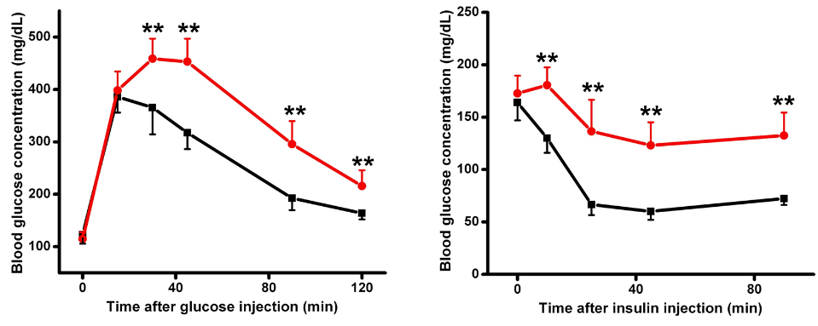
MG29 knockout mice develop diabetes
normal mice
MG29-/-
Similar to humans with diabetes, MG29-/- mice have difficulty to absorb glucose from blood circulation, and are less responsive to insulin stimulation.

Slide 30
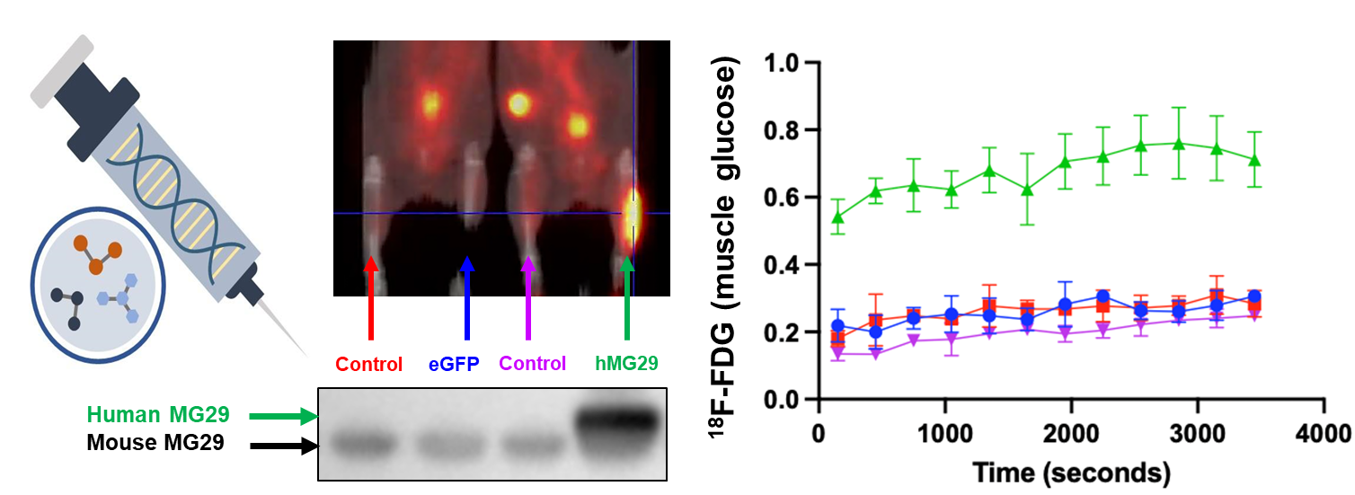
Gene therapy - delivering human MG29 into diabetic muscle to boost glucose uptake
MG29 enhances glucose uptake

Slide 31
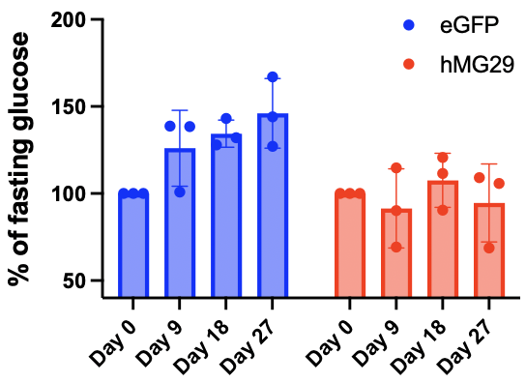
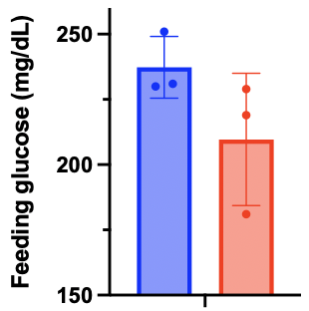
Gene therapy delivery of MG29 safely mitigates hyperglycemia in HFD-mice
Day 54

Slide 32
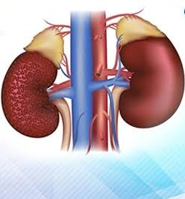
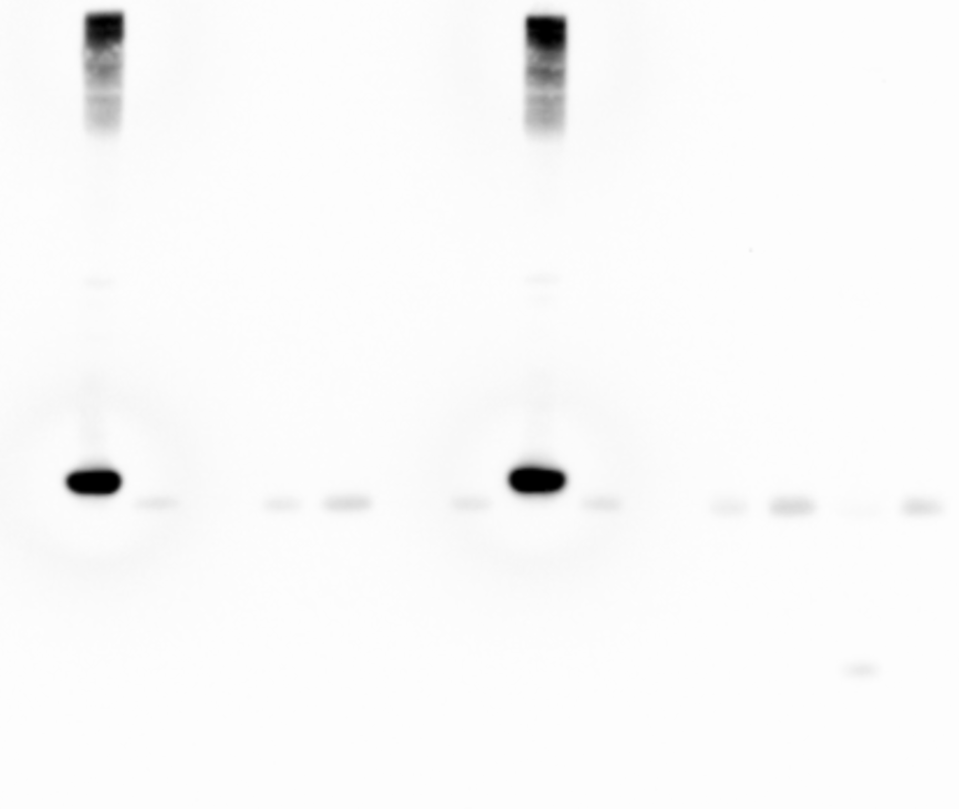
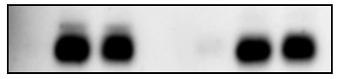
Kidney needs MG29 for protection under diabetes condition
Skeletal muscle
Skeletal muscle
Heart
Pancreas
Pancreas
Brain
Liver
Lung
Kidney
Heart
Brain
Liver
Lung
Kidney
Normal
MG29
mRNA
Protein
Kidney
Heart
MG29
Diabetes
IgG
Diabetic Nephropathy
WT HFD
WT HFD

Slide 33


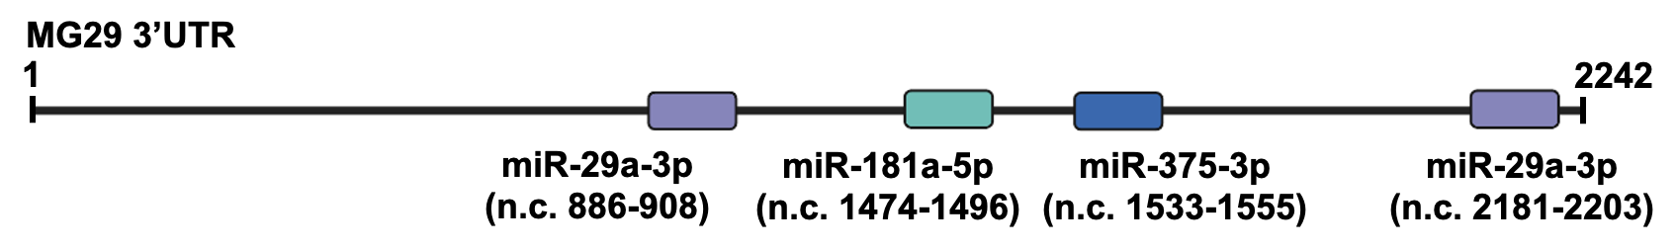
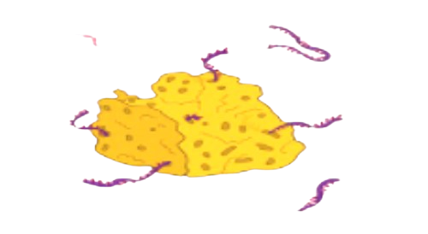
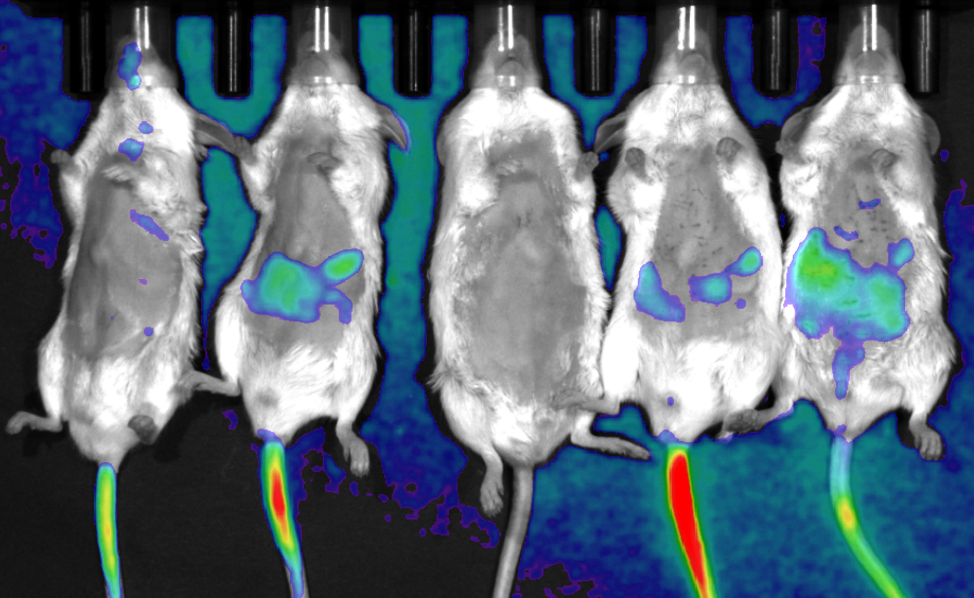

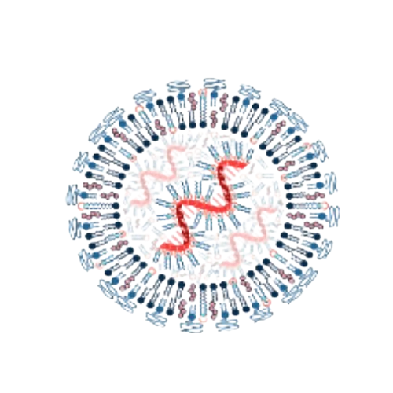
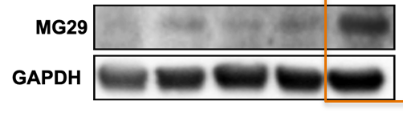
Precision medicine to treat kidney failure in diabetes
Nanoparticle delivery of “miR-sponge” to boost MG29 in the kidney
MG29 3’UTR
microRNAs block MG29 protein synthesis
miR-sponge to mitigate the inhibitory microRNAs
Nanoparticle delivery
to kidney
miR-sponge
(combo)
Control
miR-s2
miR-s1
miR-s3

Slide 34

“Developing a humanized antibody to pacify chronic inflammation for cure of diabetic foot ulcer”

Slide 35

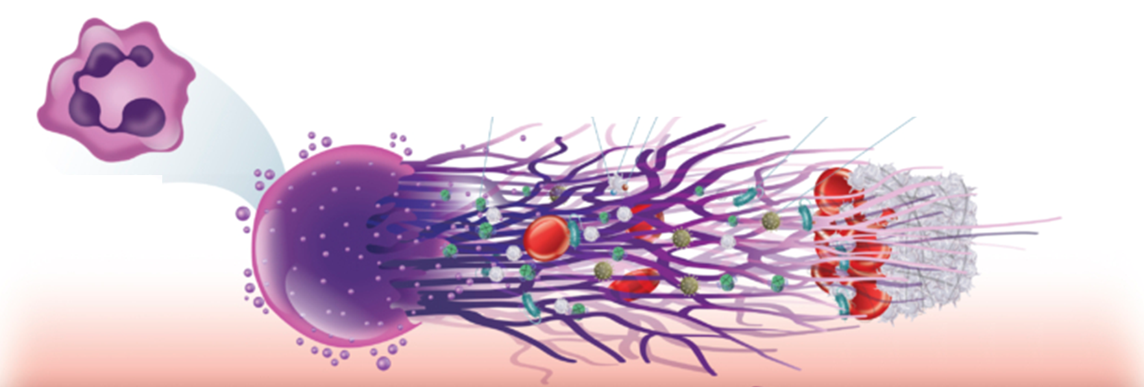
NETosis – body’s fundamental defense “flames” out of control in diabetes
Neutrophil Extracellular Trap (NET)
CitH3
Macrophage and Cell Damage
Reduced Healing Capacity

Slide 36
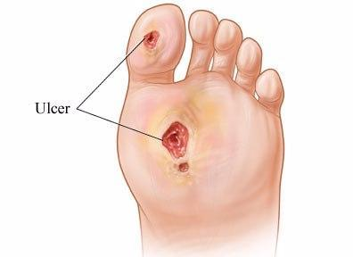
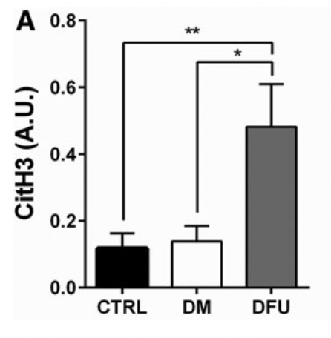
Patients with diabetic foot ulcer show elevation of CitH3
Yang et al., “Neutrophil Extracellular Traps Are Markers of Wound Healing Impairment in Patients with Diabetic Foot Ulcers Treated in a Multidisciplinary Setting.”

Slide 37
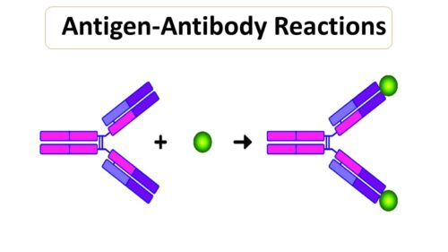
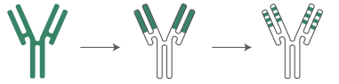
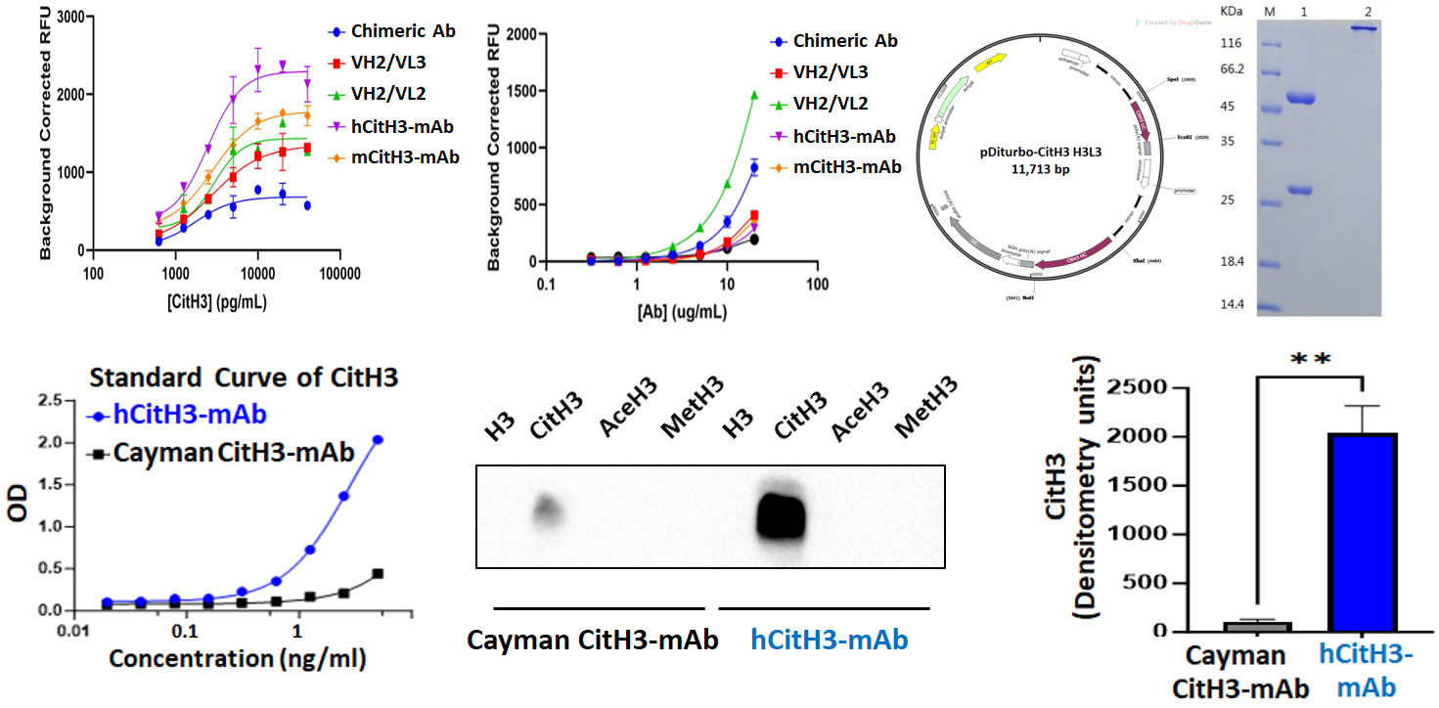
Developing a superior humanized monoclonal antibody
to trap and pacify CitH3 (hCitH3-mAb)
Mouse antibody
Chimeric antibody
Humanized antibody
CitH3
Process of antibody humanization
Commercial
hCitH3-mAb
Commercial
hCitH3-mAb

Slide 38
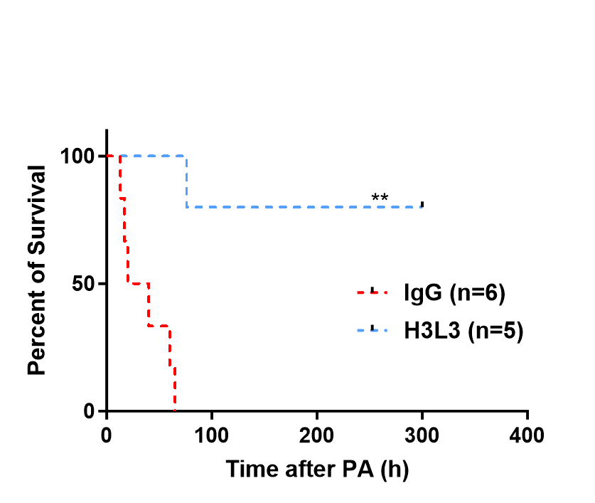
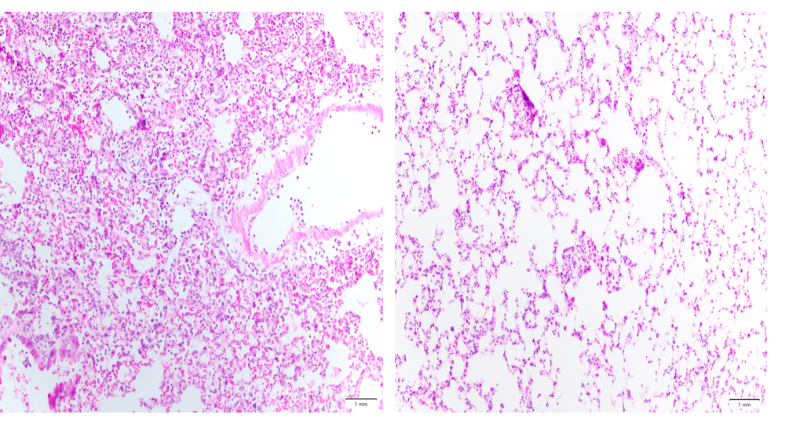
hCitH3-mAb improves survival of mice subjected
to Pseudomonas aeruginosa (PA)-induced sepsis
Control IgG
hCitH3-mAb
Control IgG
hCitH3-mAb
Bad Lung
Good Lung
Notes:
In addition to the LPS model, we also evaluated our antibody in the PA model. While the LPS model is a standard way to induce sepsis, it lacks clinical practice. And PA bacteria highly relate to hospital-acquired infections. So We administered the PA bacteria intranasally, followed by ab injection. Septic mice with H3L3 application shows a higher survival rate compared to IgG group.

Slide 39
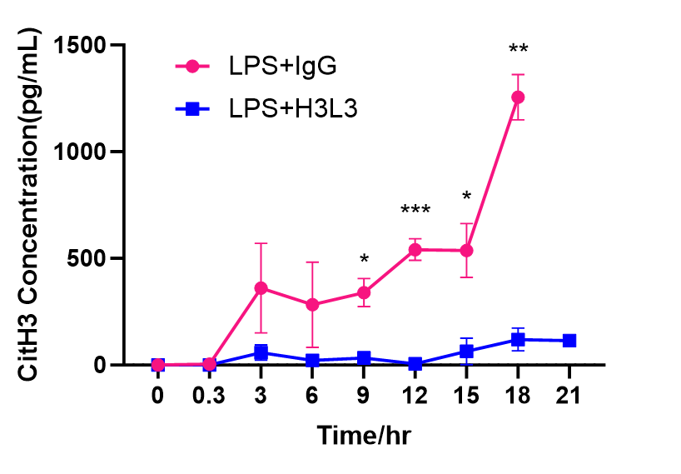
hCitH3-mAb blocks cytokine storm to save life
Control IgG
hCitH3-mAb
CitH3 -
Diagnostic marker
Critical window to treat sepsis
Indicator for chronic inflammation
Notes:
With the assistance of members from Dr. Kurabayashi’s lab, we could do a Fine-time monitoring of our model. They invented this system called PedELISA, which could use very few samples to do multiplex ELISA at the same time. So We could just take very few blood every 3 hours from tail and run this PedELISA to monitor the changes during sepsis. We could see that CitH3 was rising up from very early hours. And our antibody could effectively suppress CitH3.

Slide 40
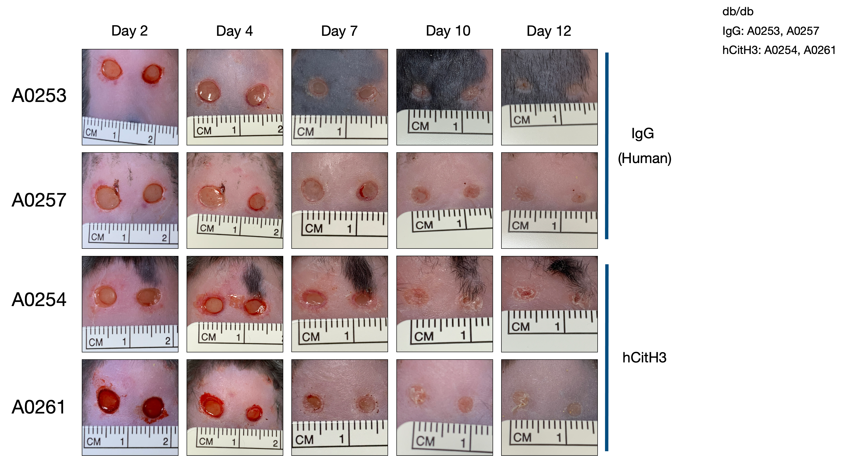
hCitH3-mAb improves healing of diabetic wound
IgG control
hCitH3-mAb
Day 1
Day 3
Day 7
Day 10
Day 12

Slide 41
Bench-to-bedside translation
IP on hCitH3-mAb jointly filed by UVA-LVG, University of Michigan and HTIC, Inc.
Need business leadership and venture support to guide translation
Partnership between HTIC, Inc., Pharmaceutical Companies, and UVA-LVG to advance commercialization
a) Produce clinical-grade hCitH3-mAb in a GMP facility
b) Establish safety profile per FDA guidance

Slide 42

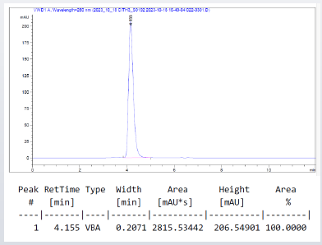
Production of hCitH3-mAb in a GMP facility
High yield of hCitH3-mAb exceeding industry standard
High quality hCitH3-mAb (>99.5% pure) has been purified

Slide 43
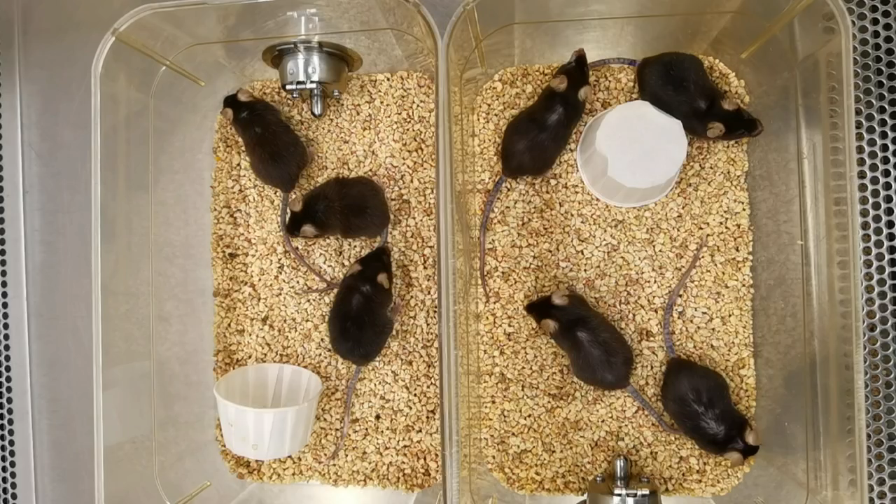
CitH3-mAb is safe in aged mice
Untreated
+CitH3-mAb

Slide 44
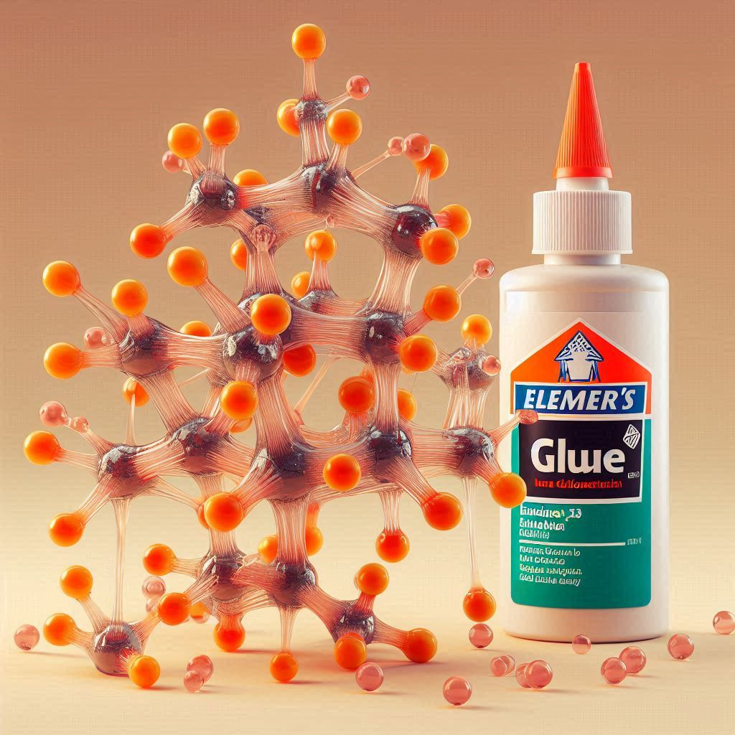
“Developing a molecular glue to enhance
healing of diabetic wounds”

Slide 45
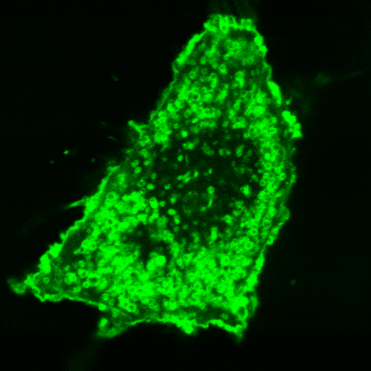
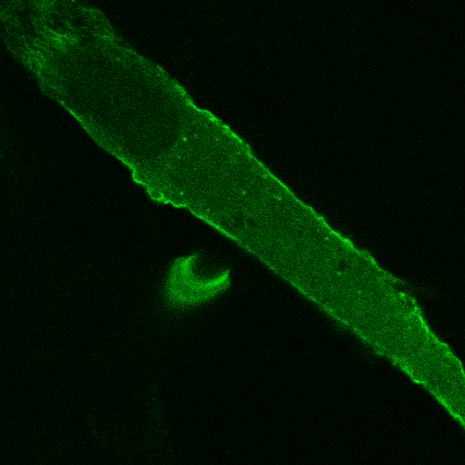
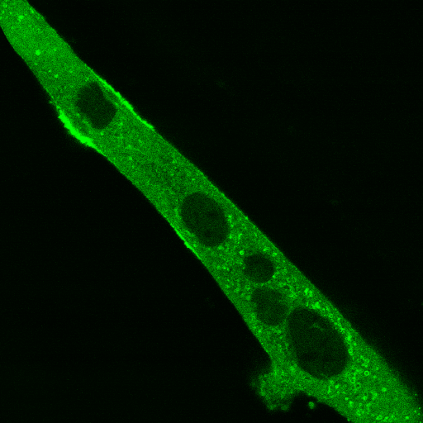
MG53 - a molecular glue to repair tissue injury
Green = MG53
Cai et al (2009) Nature Cell Biology 11: 56-64

Slide 46
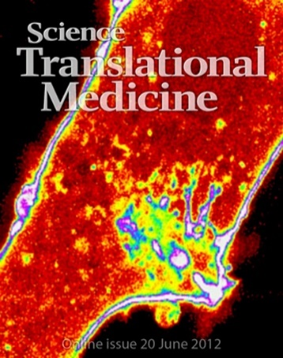

Broader application of MG53 in regenerative medicine
TEDx: Regenerative Medicine: Finding a “pixie dust” to save human lives

Slide 47
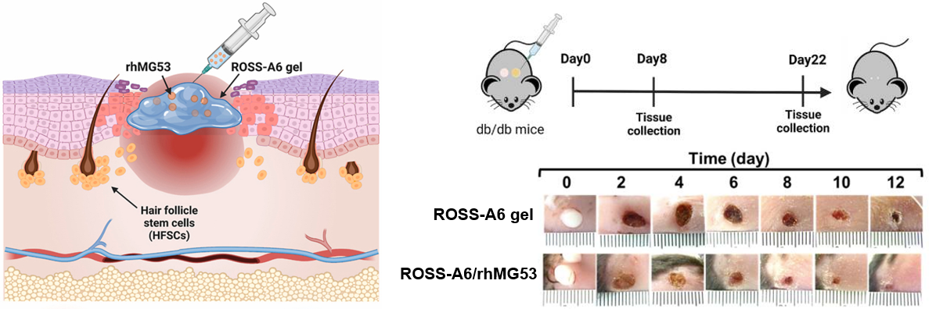
Hydrogel formulation of recombinant human MG53 protein
for topical application to treat diabetic wound
Niu et al, Bioactive Materials (2022) doi: 10.1016/j.bioactmat.2022.03.017.

Slide 48
MG53 (glue) + hCitH3-mAb (pacifier)
=
Cure for Diabetic Foot Ulcer

Slide 49

Living with diabetes - in need of
an exercise pill,
a pacifier to put out the flame,
and a glue to heal.
MG29
hCitH3-mAb
MG53

Slide 50
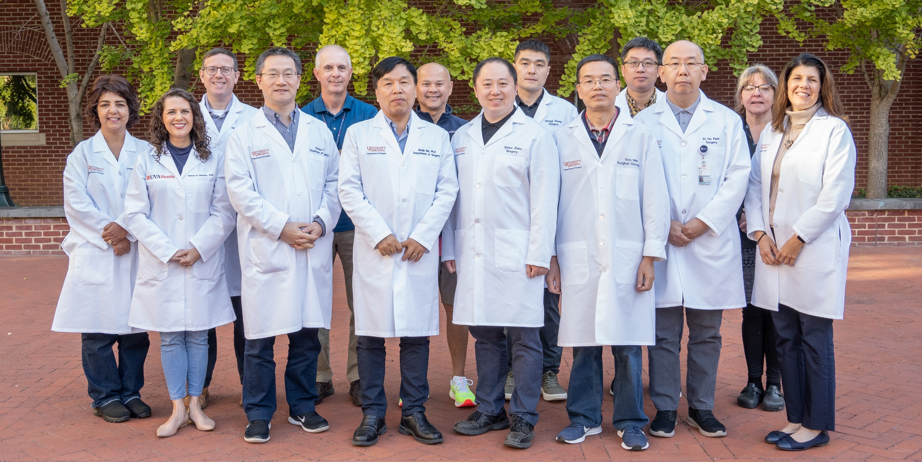
Division of Surgical Sciences - Department of Surgery at UVA

Slide 51
Acknowledgement of Team-Science at UVA
School of Medicine
Data Science (Philip Bourne)
Arts and Sciences (George Bloom)
Chemical Engineering (Liheng Cai)
Licensing & Ventures Group at UVA
Richard Chylla
Josh Mauldin
Robert Creeden
Jim Powers
HTIC, Inc.
MG Therapeutics, Inc.
Clinical Department
Plastic Surgery (Scott Hollenbeck)
Medicine (Imre North)
Ophthalmology (Albert Jun)
Neurology (Carol Manning)
Family Medicine (Li Li)
Anesthesiology (Zhiyi Zuo)
Radiology and Medical Imaging
(Maurits Jansen, Jiang He)
Basic Science Department
Neuroscience (Harald Sontheimer)
Physiology and Biophysics (Ling Qi) Biochemistry (Tian Zhang)
Genome Sciences (Chongzhi Zang)
Microbiology and Immunology
(Qiwei Wang)
Biomedical Engineering
(Shayn Peirce-Cottler)
Supported by NIA, NHLBI, NEI, NINDS, STTR, VIPC, VA-Catalyst, UVA-LaunchPad, PBM Capital

Slide 52
Next Up: Addressing Obesogenic Behaviors and Bridging the Digital Divide within Rural Communities
Dr. Jamie Zoellner, Professor of Public Health Sciences and
Registered Dietician

Slide 53

Addressing Obesogenic Behaviors and Bridging the Digital Divide within Rural Communities
Jamie Zoellner, PhD, RDN
Professor, Public Health Sciences, UVA
Co-Lead, UVA Cancer Center, Cancer Prevention & Population Health Program
Co-Director, Community Based Health Equity Program

Slide 54
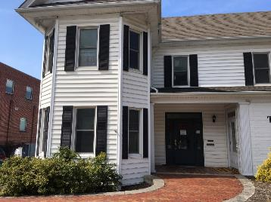

Community-Based Health Equity (CBHE) Center
Obesity & Cancer
Medically underserved rural communities
Lifestyle interventions (nutrition & PA)
Real-world systems
Participatory research methods
e/m Health
Health literacy
Transl-ational science
16 East Main St, Christiansburg, VA 24073

Slide 55
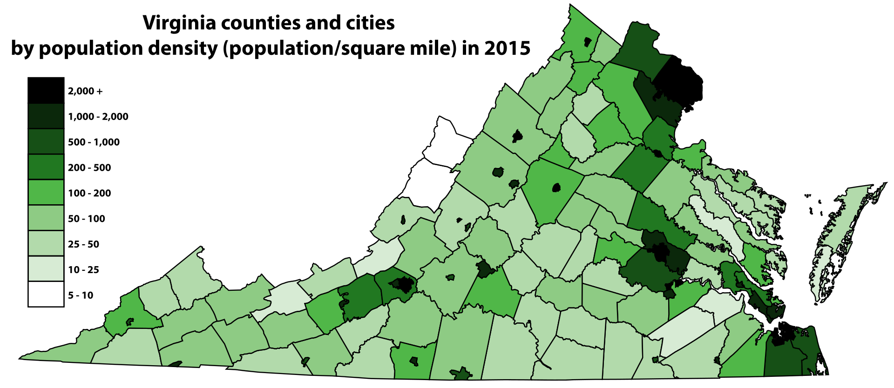
My research efforts are largely focused on Southwest and Southside Virginia and in partnership with numerous organizations:
  Federally Qualified Health Centers (FQHCs)
  Virginia Department of Health districts
  Middle schools and Head Starts
  Parks and Recreation Departments

Slide 56
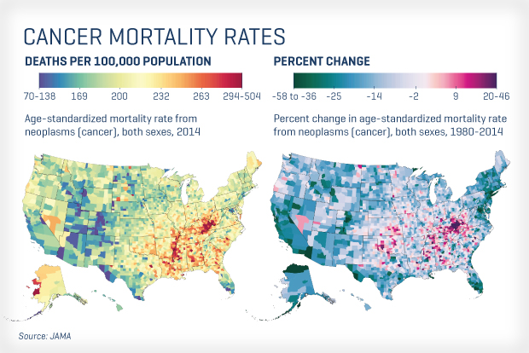

Slide 57




Community-Based Health Equity Research Focus
Sugar-sweetened beverages (SSB) reduction interventions across the lifespan (R01, NIH-NCI, 2011-2017) (R21, NIH-NCI, 2016-2018) (R01, NIH-NIMHD, 2018-2024) (R01, NIH-NIMHD, 2019-2024) (R56, NIH-NINR, 2020-2023) (UVACC, 2023-2024) (R01, NIH-NCI, 2024-2029) | Family-based childhood obesity treatment (R24, NIH-NIMHD, 2013-2016) (PCORI, 2017-2021)
Colorectal cancer screening in FQHCs (P30, NIH-NCI, 2018-2020) (iTHRIV, 2019-2020) (Jeffress Trust, 2022-2025) | Capacity building and community engagement among rural and medically-under served communities (PCORI, 2018-2021) (PCORI, 2024-2025) (UVACC, ongoing)

Slide 58

Notes:
I’m making some assuming this is an audience that is familiar with the established relationships among obesity and increased cancer risk, so I’m not spending much time on this:
12-13 types of cancer
Obesity may make the body a supportive environment for tumor cell growth.
Obesity increases inflammation; dysregulates the immune system; alters the gut microbiome; increases levels of insulin, insulin like growth factor, and leptin; and alters hormone production
Obesity impacts cancer screening, incidence, treatment, and outcomes.
Impacts and outcomes vary by type of cancer.
Addressing obesity and its co-morbid conditions, especially diabetes, as prevention or treatment interventions may impact cancer risk, incidence, and outcomes
Type 2 diabetes, which is well-associated with obesity, is a risk factor for the development of a number types of cancer

Slide 59

Sugar-Sweetened Beverages (SSB)
SSB are the largest single source of calories in the US diet
  soda/pop, sweet tea and coffees, sports and energy drinks, fruit drinks
Proportion of total energy intake:
Adults = 8%
Youth = 7%
Kit BK, Fakhouri THI, Park S, Nielsen SJ, Ogden CL. Trends in sugar-sweetened beverage consumption among youth and adults in the United States: 1999–2010. Am J Clin Nutr. 2013;98(1):180-188

Slide 60









Added Sugars and Sugar Sweetened Beverage (SSB) Recommendations
Added
Sugars
Less than 10% of total energy intake*
Less than 10% of calories per day
Less than 10% of calories per day
Limit foods and beverages with added sugars
Less than 10% of calories per day
Less than 10% of calories per day
Less than 6% of calories per day*
Sugar Sweetened Beverages
Limit to small amounts and often replace with beverage options with no added sugars, such as water
Avoid SSB which contain sucrose, high-fructose corn syrup, and fruit juice concentrates*
Limit consumption of SSB and do not consumer fruit juice in large quantities
Limit SSB consumption as part of healthy diet goal
No more than 36 ounces of SSB per week

Slide 61

SSB Trends & Disparities
Some evidence that SSB is decreasing in the United States
Relative to their counterparts,
SSB is higher among:
  racial & ethnic minorities
  low SES
  low health literate
  Ages 12-19 & 19-34
  Men
  Rural regions
Relative to metro counties,
prevalence of SSB is
↑30%
in rural counties
Bleich S, Vercammen K, Koma J, Li Z. Trends in Beverage Consumption Among Children and Adults, 2003-2014. Obesity. 2018;26(2):432-441.
Imoisili O, Park S, Lundeen EA, et al. Sugar-Sweetened Beverage Intake Among Adults, by Residence in Metropolitan and Nonmetropolitan Counties in 12 States and the District of Columbia, 2017. Preventing Chronic Disease. 2020;17:E07.
Notes:
Hales CM, Carroll MD, Fryar CD, Ogden CL. Prevalence of obesity among adults and youth: United States, 2015–2016. NCHS data brief, no 288. Hyattsville, MD: National Center for Health Statistics. 2017.
U.S. Department of Health and Human Services, Health Resources and Services Administration, Maternal and Child Health Bureau, The Health and Well-Being of Children in Rural Areas: A Portrait of the Nation, 2011-2012. Rockville, Maryland: U.S. DHHS, 2015.

Slide 62




In rural regions, provider shortages and physical barriers to healthcare access remain relatively static
Growing infrastructure of Internet services and a surge in ownership of Internet-supported devices
Notes:
(e.g. rural geographical dispersion, limited transportation)
Yet, the growing infrastructure of Internet services, surge in ownership of Internet-supported devices, and high SMS use in Appalachia Virginia confirms optimal timing to evaluate technology-based behavioral interventions.

Slide 63
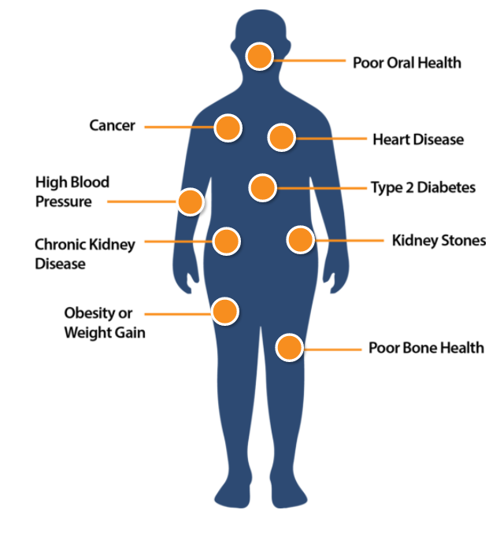
Health Consequences of SSB
There are 9 major health problems related to drinking too many sugary drinks:
Notes:
Weight gain/Obesity
The best large randomized trials support a direct association between SSB consumption and weight gain or obesity. Among the systematic reviews that reported no conflict of interest, 10/12 conclude that SSBs were directly associated with increased weight gain or obesity
Type 2 Diabetes
Habitual consumption of SSB was associated with greater incidence of type 2 diabetes, independent of adiposity. Under assumption of causality, consumption of SSB over years may be related to a substantial number of cases of new onset diabetes
Cancer
In 2 of 5 studies on added sugars, 60-95% increased cancer risk was observed with higher intakes. In 8 of 15 studies, 23-200% higher cancer risk was observer with higher SSB consumption
In this cohort of American adults, higher SSB consumption was associated with increased cancer risk among participants with central adiposity. These analyses suggest that avoiding SSB represents a simple dietary modification that may be used as an effective cancer control strategy.
Coronary Heart Disease (CHD)
Hypertension (HTN)
Dental Erosion and Decay

Slide 64










R01 NIH/NCI
2011-2017
SIPsmartER: A nutrition literacy approach to reducing sugar-sweetened beverages
RCT effectiveness trial w/ adults
R01 NIH/NIMHD
2018-2024
Kids SipSmartER: A multi-level behavioral and health literacy intervention to reduce sugar-sweetened beverages among Appalachian middle-school students
Hybrid effectiveness/
implementation trial w/ students and caregivers
R21 NIH/NCI
2016-2018
SIPsmartER Southwest Virginia: A systems-based approach to disseminate and implement an effective sugar-sweetened beverage reduction intervention
Pilot dissemination and implementation trial
(with Virginia Department of Health)
R01 NIH (NIH/NIMHD)
2019-2024
iSIPsmarter:
RCT efficacy trial w/ adults (transition to internet and SMS based modality)

Slide 65

1. R01 NIH/NCI
2011-2017
RCT SIPsmartER effectiveness trial w/ adults
2. R21 NIH/NCI
2016-2018
Pilot dissemination and implementation trial of SIPsmartER when delivered by VDH
Zoellner J, et al. Effects of a behavioral and health literacy intervention to reduce sugar-sweetened beverages: a randomized trial. International Journal of Behavioral Nutrition and Physical Activity, 13(38), 2016.
13 additional papers on methods, biomarkers, biometric data, dietary and beverage quality, theory, maintenance of outcomes
Zoellner J, et al. The reach and effectiveness of SIPsmartER when implemented by rural public health departments: A pilot dissemination and implementation trial to reduce sugary beverages. (In Press, Translational Behavioral Medicine, accepted January 2019).
Porter KP, Zoellner J*, et al. SIPsmartER delivered through rural, local health districts: Adoption and implementation outcomes. BMC Public Health, 12:1273, 2019

Slide 66

iSIPsmarter
2 group RCT: iSIPsmarter vs. static Patient Education website
4 assessment points: pre, post, 6-months post, and 18-months post
iSIPsmarter
  6 Cores + 1 Maintenance Core
  Daily diaries:
    SSB: SMS or internet program
    Weight: WIFI scale or internet program
  Stepped care for engagement
Zoellner J, et al. Study protocol for iSIPsmarter: A randomized-controlled trial to evaluate the efficacy, reach, and engagement of a technology-based behavioral intervention to reduce sugary beverages among rural Appalachian adults. Contemporary Clinical Trials, 110, 2021
Notes:
Primary aim: To determine the efficacy of iSIPsmarter at reducing SSB consumption. We hypothesize that iSIPsmarter will be more efficacious at reducing SSB consumption than a PE website at post assessment.
Secondary aims: Using iSIPsmarter, we will:
Determine its efficacy on secondary outcomes (overall dietary quality, weight, QOL, behavioral theory constructs) and the maintenance of all primary and secondary outcomes at 6- and 18-months follow-up.
Evaluate its reach and representativeness.
Describe patterns of user engagement (number of log-ins, number of cores completed, diary entries).
Estimate the added cost of delivering stepped care in iSIPsmarter and its associated value to intervention adherence and efficacy outcomes.
EXPLORATORY aimS:
Explore the influence of engagement on efficacy outcomes and explore mediators to engagement and efficacy outcomes.
In partnership with rural, Appalachia systems (i.e., health departments, community health centers, multi-service community agency), a systems-level and participatory process will be applied to better understand context for future organizational-level adoption and implementation of iSIPsmarter, and specifically explore factors that would promote or inhibit a sustainable SSB screening and referral process.

Slide 67
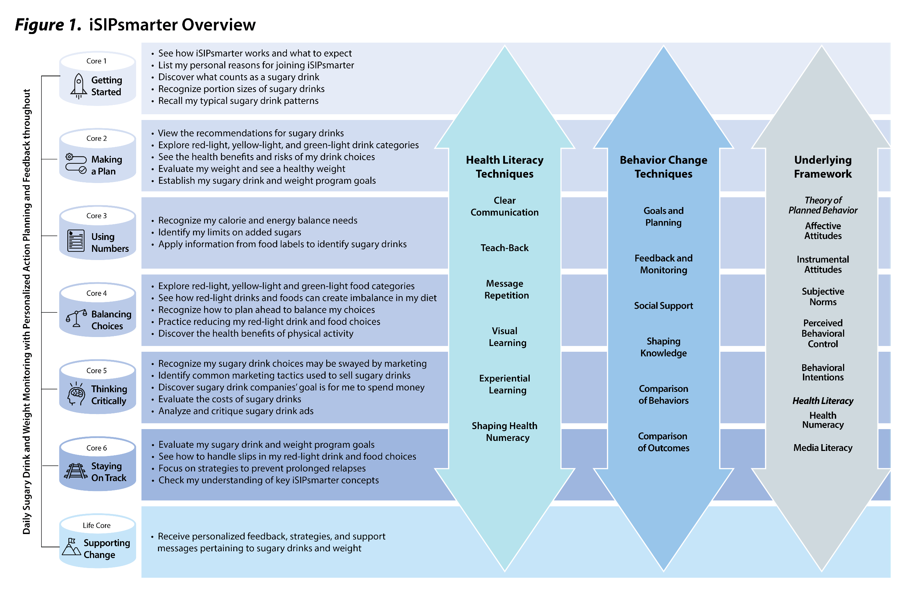

Slide 68
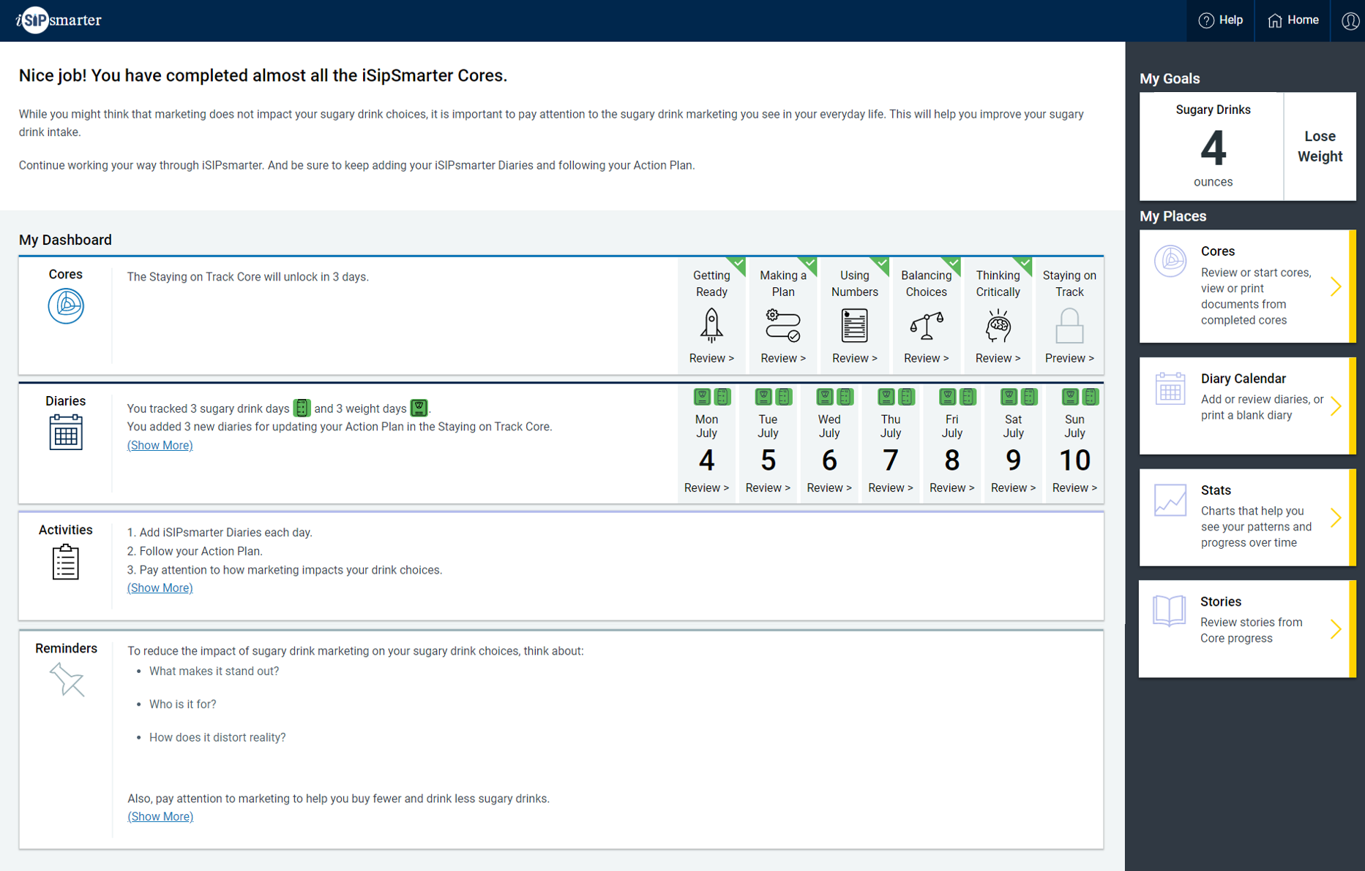

Slide 69
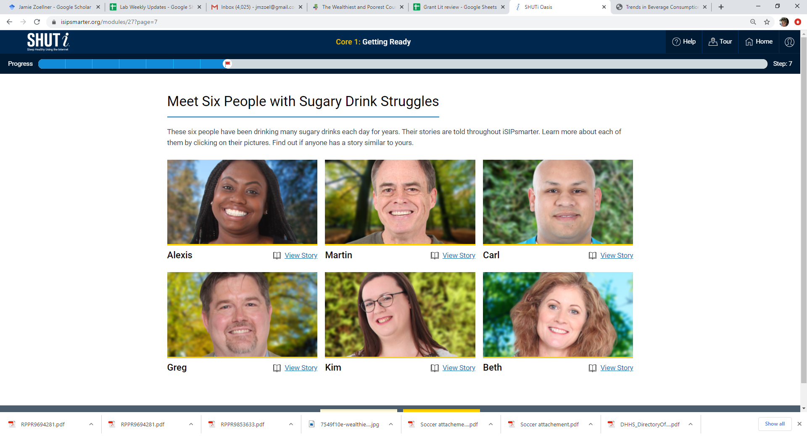

Slide 70
Our iSIPsmarter Leadership Team

Slide 71
Accrual & Retention
Recruitment:
August 2021 – December 2022
 | N (%)
Interest screeners completed | 782
Eligible | 502 (64%)
Eligible & enrolled | 249 (50%)
Eligible & not enrolled | 253 (50%)
Retention at 9 weeks | 228 (92%)
Retention at 6 months | 215 (86%)
Retention at 18 months | 211 (83%)
Notes:
Updated from consort

Slide 72
Engagement Indicators
 | Overall trial | Differences among urban (n=13), suburban (n=48) & rural (n=33) participants
Core completion (through 6m) | 4.9 (sd=1.7) of 6 Cores | none
Need for stepped care (through 9 wks) | 59% | likelihood of rural participants (46%) needing stepped care trended greater than their suburban (39%) and urban (16%) counterparts (p=0.07)
SSB tracking (through 9 wks) | 76% | none
Weight tracking (through 9 wks) | 57% | none
Retention (through 6 m) | 88% | none
Notes:
updated

Slide 73
SSB Changes
ES = 0.37
(p=0.012)
ES = 0.35
(p=0.017)
ES = 0.34
(p=0.011)
*p<0.05, **p<0.01, ***p<0.001
Notes:
Donna update with 6-month and 18-month findings – need both SSB and weight

Slide 74
Weight Changes
ES = 0.23
(p=0.046)
ES = 0.58
(p<0.001)
*p<0.05, **p<0.01, ***p<0.001
Notes:
Donna update with 6-month and 18-month findings – need both SSB and weight

Slide 75
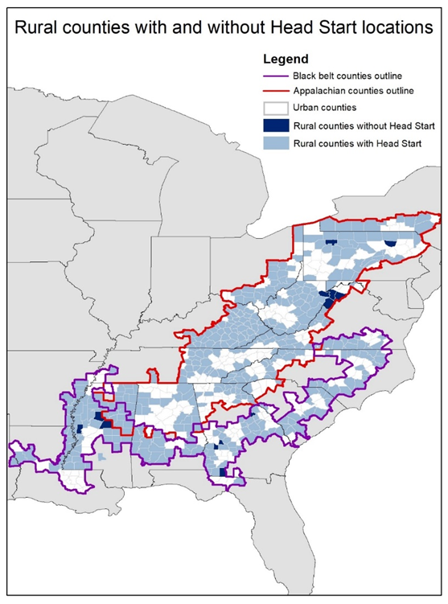
R01 (NIH/NCI)
2024-2029
weSIPsmarter:
An adaptation and efficacy trial to evaluate a behaviorally based digital health intervention aimed at reducing sugary drinks among rural Head Start preschoolers and their parents
Zoellner J, et al., Beverage behaviors and correlates among Head Start preschooler-parent dyads. Maternal and Child Health, 26(11):2271-2282, 2022
Notes:
Zoellner J*, Kirkpatrick B, Allanson D, Mariner K, Cuy-Castellanos D, Miller B, Foster Z, Martin T. Beverage behaviors and correlates among Head Start preschooler-parent dyads. Maternal and Child Health, 26(11):2271-2282, 2022

Slide 76




What is Kids SIPsmartER?
  6-month, multi-level, school-based intervention
  Aimed at improving SSB behaviors among middle students and their caregivers
  Theory of Planned Behavior
  Health literacy
  Media literacy
  Numeracy
  Public health literacy
+
12 classroom lessons (co-) taught by classroom teachers
Integrated text message program for parent/caregiver
Zoellner J, et al., Kids SIPsmartER, a cluster randomized controlled trial and multi-level intervention to improve sugar-sweetened beverages behaviors among Appalachian middle-school students: Rationale, design & methods. Contemp Clin Trials. 2019 Aug; 83:64-80
Notes:
A little bit more about the actual intervention, it’s grounded in theory of planned behavrio, health literacy, media literacy, numeracy, and public health literacy concepts.
It’s mulit-level because it has a student and a caregiver component. Students recieve 12 lesson integrated into their health or PE curriculum, and at the same time parents are enrolled into a text messaging internvetion that mirrors the conent students are getting in class. So as mentioned previously, my work really focuses on the development and implementation of this parent caregiver component.
However I do have a multitude of roles related to the student side as well. I am involved in implementation, form curriculum design, and now actually implementing the program in schools. I am involved in all data collection and training of the teachers in the KSS curriculum.
Today I will present to you work that answered some of these formative questions as related to the KSS Internvetion:
Why focus on sugar-sweetened Beverages?
Why do we have a parent/caregiver component?
How can we make messages culturally relevant and will an SMS-based intervention be acceptable?

Slide 77

Kids SIPsmartER Study Design?
12 rural Appalachian middle schools
Type 1 hybrid design & cluster RCT
  Primary aim: effectiveness
  Secondary aim: implementation
Zoellner J, et al., Kids SIPsmartER, a cluster randomized controlled trial and multi-level intervention to improve sugar-sweetened beverages behaviors among Appalachian middle-school students: Rationale, design & methods. Contemp Clin Trials. 2019 Aug; 83:64-80.
Notes:
SO what is KSS?
Well this multii, level bheavrioal program, is a 6-month, school-based, intervention aimed at improving SSB behaviors among 7th grade students.
We plan to partner with 12 rural Appalachian middle schools over the 5 years of this project, we are currently in year 2, and we have 8 schools on board thus far. \
This study is a type 1 hydbrid implementation- effectiveness and cluster randomized control trial. And like I said we are funded for five years, we are currently on year 2.
As a primary outcome, we are looking for changes in SSB bheavrios among students at schools receiving Kids SIPsmartER, compared to control schools
But also as one of our seconday outcome we are looking at changes in the parent or caregiver SSB behaviors. And I specifically mention this, because this is where a lot of my work has been concentrated, and the formative work I’ve done really targets the portion of the intervention that drives this secondary outcome.
If you are interested in knowing more about the methodology of this project, I’ll direct you to our recently published manuscript, which you see cited as the bottom of the screen.

Slide 78



Year 1: KSS co-delivered by researcher + teacher
Year 2 (and beyond): KSS by teacher

Slide 79




Slide 81









Our Schools
Thank you to our dedicated schools!

Slide 82
Methods
Eligibility
Data Collection
Data Analysis
Zoellner J, et al., Kids SIPsmartER, a cluster randomized controlled trial and multi-level intervention to improve sugar-sweetened beverages behaviors among Appalachian middle-school students: Rationale, design & methods. Contemp Clin Trials. 2019 Aug; 83:64-80.
Notes:
Eligibility: All students and caregivers are eligible to participate, regardless of SSB behaviors at baseline.
Data collection: baseline and 7-months. Validated BEV-Q is used to assess SSB behaviors. Height and weight measure among students, self-reported among adults
Analysis: Both student and caregiver analyses included modified two-part models, with time fixed effects, that controlled for relevant demographics and included school cluster robust standard errors.
Completer analyses that exclude extreme outliers are presented,
intention to treat mixed model
analyses revealed comparable findings

Slide 83
Consort
Students | Intervention | Control
Eligible | 620 | 802
Enrolled | 357 (58%) | 303 (38%)
7-month f/u | 329 (92%) | 258 (84%)
Caregivers | Intervention | Control
Eligible | 620 | 802
Enrolled | 190 (31%) | 158 (20%)
7-month f/u | 126 (66%) | 110 (70%)
Notes:
The study CONSORT diagram is illustrated in Figure 1. Of 14 schools approached for trial participation, 12 agreed and were enrolled and randomized. One school district declined due to perceived sensitivity of student weight data collection, while the other never responded to contact attempts. Of approximately 620 attending students from the 6 intervention schools, 357 (58%) enrolled in the study, of which 328 (92%) completed the 7-month follow-up. Of approximately 802 attending students from the 6 control schools, 308 (38%) enrolled in the study and 258 (82%) completed the follow-up. Additionally, 190 (31%) and 158 (20%) caregivers enrolled in the intervention and control arms, respectively. Of these, 129 (68%) intervention caregivers and 111 (70%) control caregivers completed the 7-month follow-up.

Slide 84
Demographics
Of 526 students:
  12.7 (0.5) mean age in years
  55% female
  46% with unhealthy weight: 18% with overweight, 28% with obesity
Of 220 caregivers:
  40.6 (6.7) mean age in years
  95% female
  93% White
  25% high school education or less
  33% lived in households with annual income less than $50,000
  70% with unhealthy weight: 26% with overweight, 44% with obesity
Zoellner J, et al., Kids SIPsmartER reduces sugar-sweetened beverages among Appalachian middle-school students and their caregivers: a cluster randomized controlled trial. International Journal of Behavioral Nutrition and Physical Activity, 21(46), 2024.
Notes:
Of 587 students and 236 caregivers with completed baseline and 7-month surveys, 61 (10%) and 16 (7%), respectively, were removed based on this criterion (Figure 1).
Notably, 46% of students were at an unhealthy weight, including 18% with overweight, 19% with obesity, and 9% with severe obesity.
Also, 26%, 19%, and 25% were with overweight, obesity and severe obesity, respectively.

Slide 85
Heterogeneity of treatment effects (HTE)
Main goals of HTE analysis are to estimate treatment effects in clinically relevant subgroups and to predict whether an individual might benefit from a treatment
  e.g., SSB at baseline: >8 ounces, >12 ounces, >24 ounces
Exploring HTE is especially important in primary prevention trials, when inclusion criteria are very broad
Notes:
HTE is the nonrandom, explainable variability in the direction and magnitude of treatment effects for individuals within a population

Slide 86

Student 0–7-month SSB change, overall and by baseline consumer level
ES = 0.35
(p<0.001)
ES = 0.45
(p=0.003)
Notes:
Effect size all consumers = 0.35
Effect size >24 ounces = 0.45
Among students who consumed >8 (n=407, 77%), >12 (n=349, 66%), and >24 (n=223, 42%) SSB ounces/day at baseline, ES increased to 0.38, 0.33, and 0.45, respectively (Table 3, Figure 2).

Slide 87

Caregiver 0–7-month SSB change, overall and by baseline consumer level
ES = 0.31
(p=0.018)
ES = 0.71
(p=0.004)
Notes:
Effect size all consumers = 0.31
Effect size >24 ounces = 0.71
Among caregivers who consumed >8 (n=128, 58%), >12 (n=108, 49%), and >24 (n=61, 28%) SSB ounces/day at baseline, ES increased to 0.78, 0.98, and 0.95, respectively

Slide 88

Student 0–7-month BMI Percentile Change, overall and by baseline consumer level
ES = 0.005
(p=0.645)
ES = 0.25
(p=0.087)
Notes:
Inferential sub-group analysis still underway

Slide 89

Caregiver 0–7-month BMI Unit Change, overall and by baseline consumer level
ES = 0.47
(p<0.001)
ES = 1.07
(p<0.001)
Notes:
Inferential sub-group analysis still underway

Slide 90

Student 0–7-month SSB change,
Researcher vs. Teacher Delivered
ES=0.35**
ES=0.25*
ES=0.75**
Zoellner J, et al., Comparison of Researcher-Led versus Teacher-Led effectiveness and fidelity: A Hybrid Type 1 effectiveness-implementation trial of Kids SIPsmartER in Appalachia middle schools. Translational Behavioral Medicine, 14(10):578-587, 2024.
Notes:
Donna can you add

Slide 91

Other Highlights
Reach:
>2,600 enrolled in the Clinical Trial (NCT03740113)
>7,000 students received KSS between 2018-2024
Adoption & Maintenance:
10 of 12 schools have maintained KSS
Publications:
14 published peer review articles
Notes:
Donna can you make this into a better and more visually appeallng slide?
Secondary Aims:
Secondary 7-month effectiveness outcomes:
student outcomes (e.g., quality of life, BMI z-score, theory-related variables, health and media literacy)
caregiver outcomes (e.g., SSB behaviors and home environment)
Maintenance outcomes: at 19-months post-baseline
Reach: assess the reach and representativeness of Kids SIPsmartER, among students and caregivers
Implementation, adoption, and school-level maintenance:
assess the degree to which teachers implement Kids SIPsmartER as intended
examine potential for institutionalization within the schools
1,698 students and 907

Slide 92



Next Steps: R01 Grant Renewal
(March, October 2024)
60 middle schools across rural Appalachia Virginia and West Virginia
Cluster, sequential multiple-assignment randomized trial (SMART) design
  Primary aim: intervention fidelity, sustainment, and costs
  Secondary aim: student and caregiver behaviors

Slide 93
Community-Based Health Equity Research Focus
Sugar-sweetened beverages (SSB) reduction interventions across the lifespan (R01, NIH-NCI, 2011-2017) (R21, NIH-NCI, 2016-2018) (R01, NIH-NIMHD, 2018-2024) (R01, NIH-NIMHD, 2019-2024) (R56, NIH-NINR, 2020-2023) (UVACC, 2023-2024) (R01, NIH-NCI, 2024-2029) | Family-based childhood obesity treatment (R24, NIH-NIMHD, 2013-2016) (PCORI, 2017-2021)
Colorectal cancer screening in FQHCs (P30, NIH-NCI, 2018-2020) (iTHRIV, 2019-2020) (Jeffress Trust, 2022-2025) | Capacity building and community engagement among rural and medically-under served communities (PCORI, 2018-2021) (PCORI, 2024-2025) (UVACC, ongoing)

Slide 94



Cancer Control & Population Health Program (CPH) Leaders & Aims
Li Li, MD, PhD
Cancer etiology, colon cancer, population cohort designs, cancer screening, cancer prevention and primary care
Aim 1: Investigate and advance the science on multi-level etiology in cancer risk and progression, taking a cell-to-society perspective.
Aim 2: Develop novel interventions and implement research advances in diverse populations to reduce cancer risk and cancer disparities.
Aim 3: Develop and implement novel interventions for cancer patients and cancer survivors to optimize outcomes and achieve health equity.
Jamie Zoellner, PhD, RD
Obesity prevention & treatment, cancer prevention, rural health disparities, community-based participatory research, translational research
Kelly Shaffer, PhD
Digital health interventions to mitigate the burden of cancer on patients, survivors, and families

Slide 95



CPH and the Office of
Community Outreach and Engagement (COE)
Notes:
Community Advisory Boards and Councils
My Leadership Roles
Ask Brenna if she can paste this in and make it look less blurry

Slide 96
Acknowledgements
iSIP & KSS Investigators
Kathleen Porter, PhD, RD
Wen You, PhD
Lee Ritterband, PhD (MPI, iSIPsmater)
Phil Chow, PhD
Deb Tate, PhD
Community Partners & Participants
Lab Team
Donna Brock, MS
Annie Loyd, MPH, RDN, CHES
Brittany McCormick, DHS
Teace Markwalter, MPH
Past students & staff
Any questions?
Email: jz9q@virginia.edu

Slide 97
Next Up: OSP Post Award Update
Urmila Bajaj, Director of Post Award, OSP

Slide 98

Workday Reports
Find Awards
Presented by OSP Post Award
March 4, 2025

Slide 99


Workday Reports for Identifying Awards/Grants
Find Awards
Find My Awards for Grant Managers & PI

Slide 100
Report Output for Workday “Find Awards”
Award Level Information
Grant (Award Line) Level Information
Award Number
Institutional ID
Sponsor
Sponsor Award Reference Number
Prime Sponsor
Federal Award Id Number (FAIN)
Assistance Listing Number (ALN)
Award Lifecycle Status
Authorized Amount
Billed to Date Amount
Cost Share Total Amount
Grant
Award Line, Award Line Lifecycle Status
Award Line From Date, Award Line To Date
Award Line Current Amount, Award Line Billed Amount
Award Line Remaining Balance
Award Line Type
Award Line Rate Agreement, Award Line Cost Rate Type
Award Line F&A Rate
Award Line Spend Restriction
Subrecipient
SIS Allowed

Slide 101
Report Output for Workday “Find My Awards Report for GMs & PIs”
Award Level Information
Grant (Award Line) Level Information
Lead PI
Award
Award Description
Sponsor
Sponsor Award Reference Number
Institutional ID
Award Cost Center
Assistance Listing Number (ALN)
Prime Sponsor
Award Analyst
Grant, Grant Cost Center, Grant Principal Investigator
Grant Start Date, Grant End Date
Grant Rate Agreement, Cost Rate Type
Grant Spend Restriction, Grant Lifecycle Status
Grant Current Amount, Grant Billed Amount, Remaining Balance
Grant Line Type
Grant Manager
Grant Account Certifier
Grant Financial Analyst
Subrecipient

Slide 102
ResearchUVA
Updates
Office of Sponsored Programs
March 2025

Slide 103
ResearchUVA Updates
March 6: Research Security update
Beginning in March: Upgrade to version 10.5
Beginning in Fall 2025: Huron IRB module

Slide 104
Research Security Review - Background
Under the CHIPS Act, when reviewing entities involved in sponsored research, the primary focus is to ensure that no "foreign entities of concern" provide funding or enter into a contractual relationship with UVA.
Info Team and Office of Research Security perform thorough checks to identify any potential risks of sensitive technology transfer to countries considered adversaries, and to prevent them from participating in research projects funded by the CHIPS Act.
This vetting also prevents UVA doing business with entities that are on a variety of US prohibited lists for other reasons (e.g., export control, malign foreign talent programs, sanctions, malicious code in products, human rights violations, etc.).

Slide 105
Research Security Review – Current Process
New entities (sponsors or agreement counterparties) are reviewed by both Info Team and, depending on the findings, ORS.
ORS assesses the risk of contracting with the new entity and coordinates with the PI as needed.
Some entities are flagged for additional review by ORS if/when we initiate another proposal, agreement, award or modification.

Slide 106

Research Security Review – Update to RUVA
The update to RUVA on March 6th will be to add a warning on the record workspace.
If a flagged entity is selected in the creation of a proposal, agreement, award or modification the warning will appear.

Slide 107
Research Security Review – Process Changes
Do I need to do anything different to request a new entity? NO.
There will be no change to the standard business process of requesting a new entity record in RUVA. Email osp-infoteam@virginia.edu to set up the new sponsor/counterparty.
The proposal or agreement will be held (not submitted or signed) until the new entity is vetted and created.
During the initial vetting process, ORS may reach out if there is risk identified.

Slide 108
Research Security Review – Process Changes
Do I need to do anything if I select an existing entity and see the warning message on the RUVA workspace? YES.
Create a required Ancillary Review to route to ORS for review.
You may submit the proposal to the Specialist or the agreement to OSP after the Ancillary Review is created.
The proposal cannot be submitted to the sponsor and the agreement cannot be signed until ORS review is complete.
Any risk assessment documentation will be uploaded to the record.

Slide 109
ResearchUVA Updates
March 6: Research Security update
Beginning in March: Upgrade to version 10.5
Beginning in Fall 2025: Huron IRB module

Slide 110
RUVA 10.5 Upgrade – Grants Module
Proposal Budget:
Users can define partial-month budget periods to refine budget calculations
Users can enter and view personnel effort in preferred metric: percent or months
Users can allocate personnel effort to calendar, summer, or academic months

Slide 111
RUVA 10.5 Upgrade – Grants Module
Ancillary Review:
Ancillary Reviewers retain access after completing review
Deliverables:
Users with edit access to the parent Award will be able to complete the Deliverable

Slide 112
RUVA 10.5 Upgrade – SF424
Added support for new and updated forms in Grants.gov
Added override to edit fields in Grants.gov Lobbying Form V1.1
Updated SF424 setting defaults
Updated default display order on Research & Related Senior/Key Person forms: Other Significant Contributors will be listed last on Senior/Key Person forms by default.

Slide 113
RUVA 10.5 Upgrade – Agreements
Enable OSP to modify the Agreement title
Apply updates to the final agreement file without having to modifying the draft agreement file
Enable users to apply tags to an agreement or amendment
Made usability improvements to the Submit Ancillary Review activity
Moved ancillary reviews from the workspace summary to its own Ancillary Reviews tab
Renamed signing activities and states to make it more intuitive: Internal/External Signatures

Slide 114
ResearchUVA Updates
March 6: Research Security update
Beginning in March: Upgrade to version 10.5
Beginning in Fall 2025: Huron IRB module

Slide 115

Huron IRB Module
https://hrpp.research.virginia.edu/hurons-irb-system-demo-uva

Slide 116
Thank you for attending the Research Administrators Forum
March 4th, 2025

